Slide 1
Alcohol consumption data
Data collected from students at 2 Portuguese secondary schools
Students were surveyed in either a math class or Portuguese language class
Ages ranged from 15 to 22
Alcohol consumption was reported in terms of a 1 (very low) to 5 (very high) rating on weekdays and weekends
31 other variables included family demographics, school performance, and social activities
Illegal consumption of alcohol is not necessarily a concern because as of 2014, Portugal laws allowed anyone 16 or older to purchase alcohol [1]
Additional data was acquired via a survey of University of Utah students
Students were from chemical engineering department and data science course
Subset of variables from main data were included
1. http://www.who.int/substance_abuse/publications/global_alcohol_report/profiles/prt.pdf

Slide 2
Data Cleanup
Since data was gathered in both math classes and Portuguese classes, some students were surveyed twice
Data was reported in two sets, one for math classes and another for Portuguese classes
To remove duplicates from the data, a merge was performed between the two sets
All variables except those related directly to the class (grades, attendance) type were used as a basis of comparison for the merge
Class-dependent variables were combined into single values for each student by averaging
Categorical variables were converted to integer values

Slide 3
Clustering
Three different clustering algorithms were implemented
k-Means
Hierarchical
DBSCAN
Purpose
If clusters are present, we can see what the clusters consist of to give us new insights
Example: Maybe there’s a cluster of students with divorced parents?

Slide 4
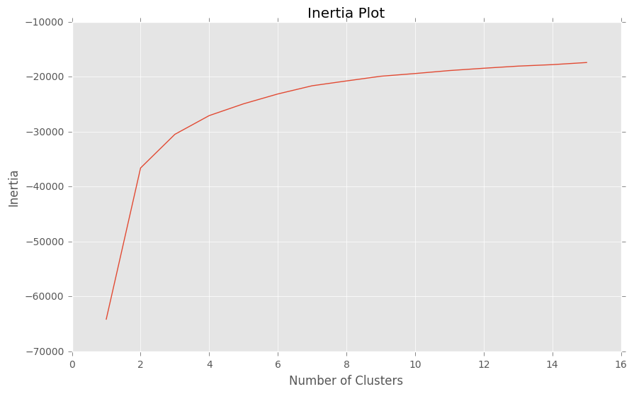
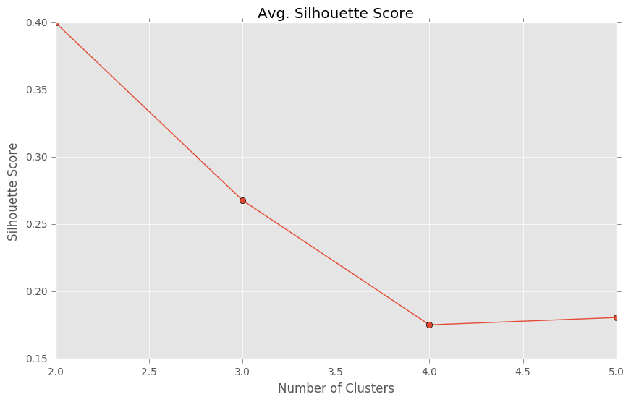
k-Means
Tried one through fifteen clusters
Decided to focus on two through five clusters
Silhouette Score (measure of distance from other clusters) wasn’t promising
+1 is best, -1 is worst

Slide 5
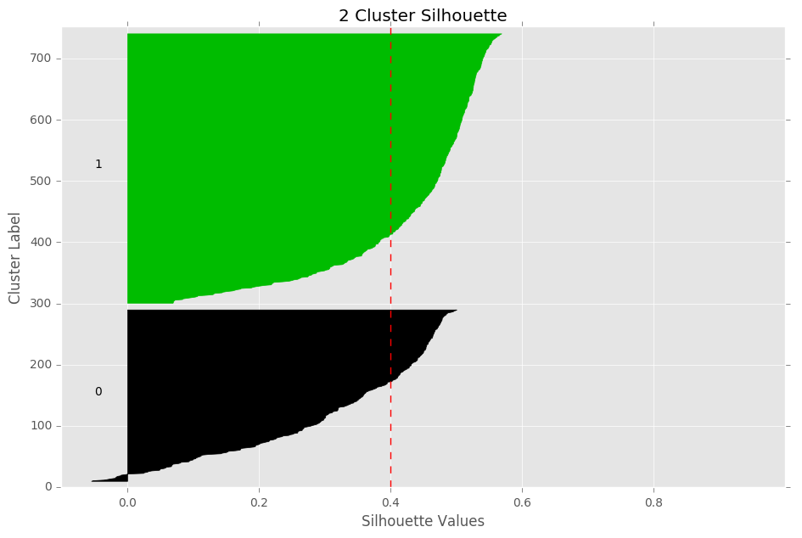
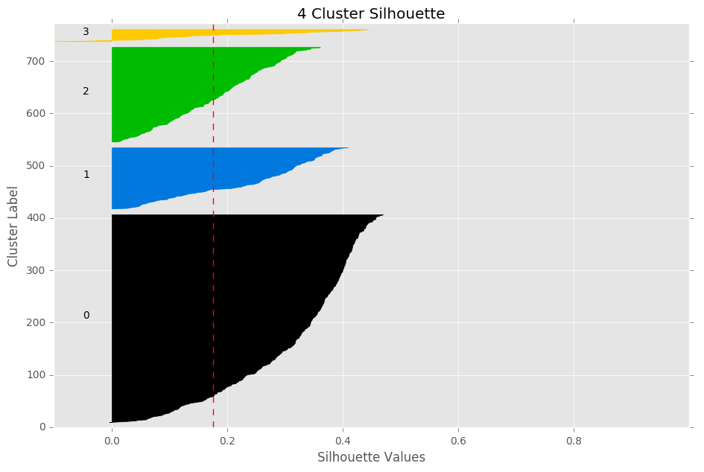
k-Means Silhouette Plots
Silhouettes aren’t close to +1, shape isn’t boxy

Slide 6
What about Hierarchical?

Slide 7
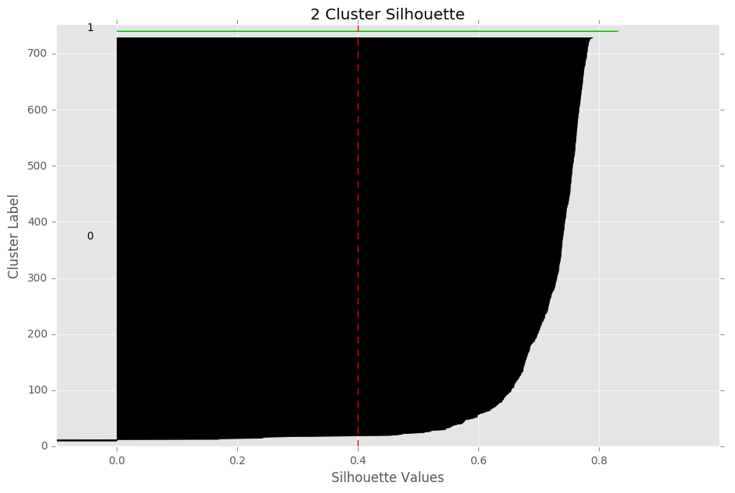
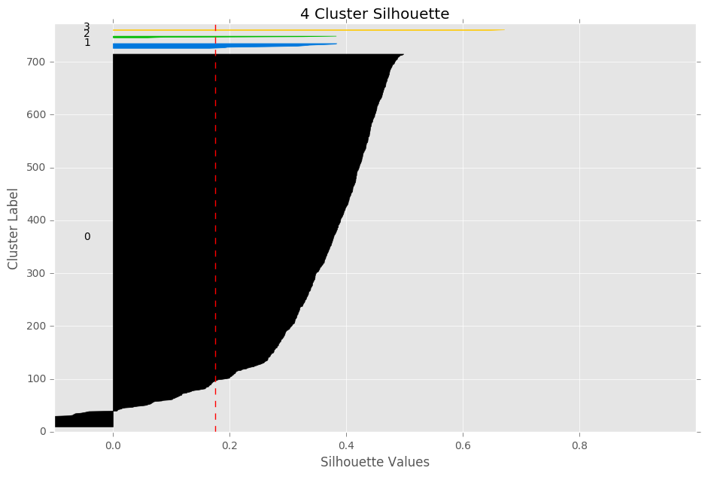
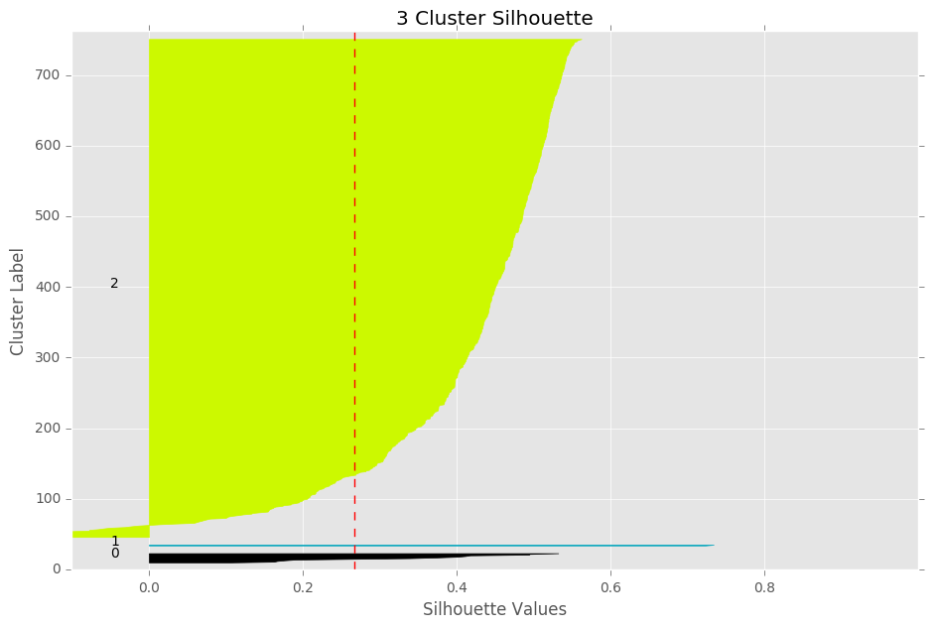
Hierarchical Silhouette Plots

Slide 8
DBSCAN
Tried one last algorithm, DBSCAN
DBSCAN determines the number of clusters for you
DBSCAN classified all points as noise
This may imply that there are no real clusters, or one large cluster

Slide 9
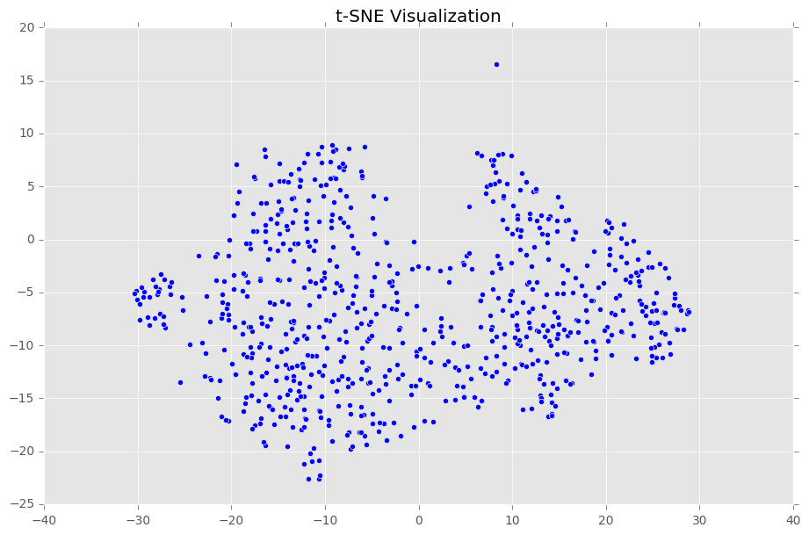
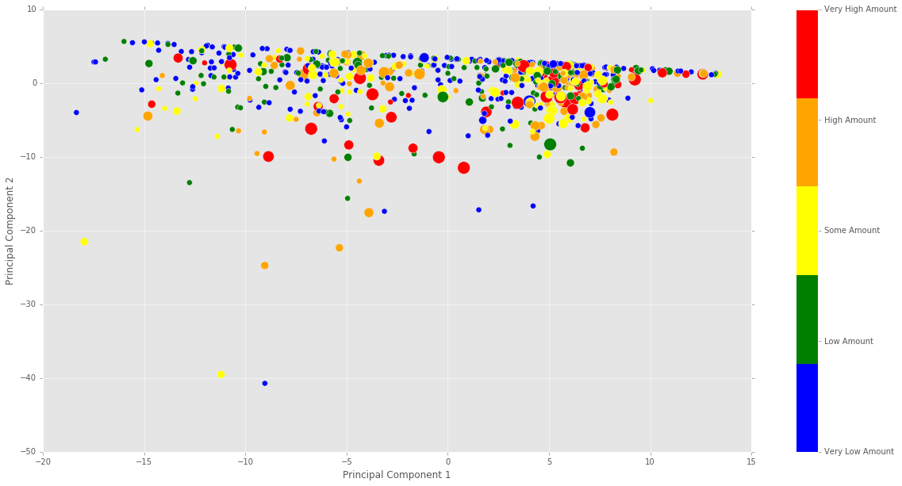
Dimensionality Reduction - Visualization
t-SNE
PCA

Slide 10
Survey

Slide 11
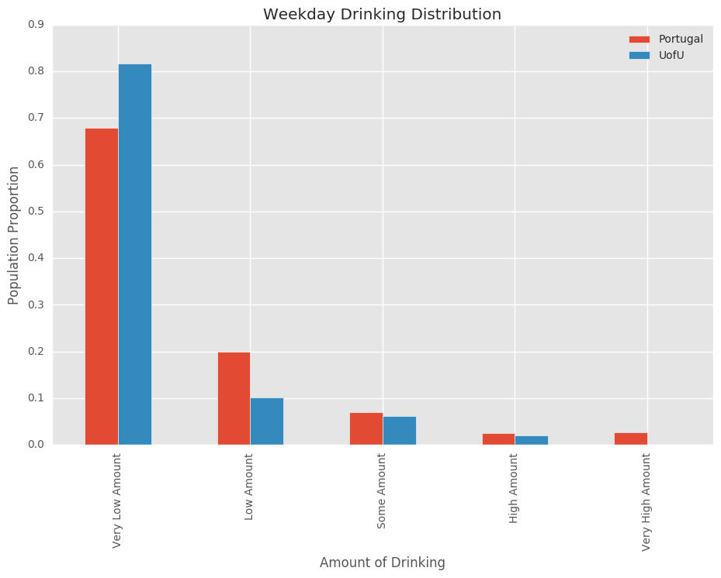
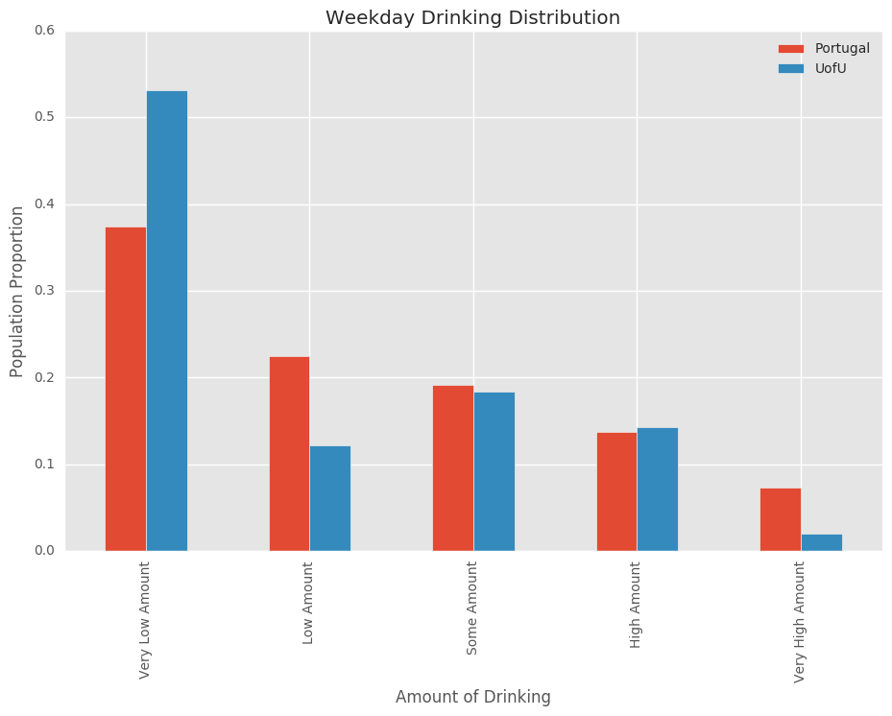
Alcohol Consumption

